Slide 1

MATH30
Probability and Statistics

Slide 2
Methods of Data Collection
Primary data can be obtained through
Direct or interview method
- Subject-to-subject exchange between the interviewer and interviewee
Indirect or questionnaire method
Registration method
- gathering of information is enforced by certain laws (e. g. Registration of births, deaths, motor vehicles, marriages, and licenses)
- systematized
Experimentation
- the objective is to determine the cause and effect relationship of certain phenomena under controlled conditions

Slide 3
Methods of Data Collection
Observation – the current status of a phenomenon is determined not by asking but by observing.
Secondary data can be obtained from
Journals and periodicals
Newspapers
Tables
Unpublished or published research papers
Theses and dissertations

Slide 4
Data Presentation
Tabular Form
4 essential parts
- table heading
- stubs (classifications or categories)
- boxhead (stubhead, master caption, & column caption)
- body

Slide 5
Data Presentation
Table Number
Title
Boxhead
Stubs Body
STUB HEAD | MASTER CAPTION |  | TOTAL
 | COLUMN CAPTION | COLUMN CAPTION
ROW CAPTION ROW CAPTION ROW CAPTION ROW CAPTION |  |  | ROW CAPTION ROW CAPTION ROW CAPTION ROW CAPTION
TOTAL | COLUMN TOTAL | COLUMN TOTAL | GRAND TOTAL

Slide 6
Data Presentation
Graphical Form
Bar Graph (Horizontal or Vertical)
- for multiple responses or overlapping categories
Line Chart
- to show a trend over a period of time
Pie/circle Graph
- to show the component parts of a whole / for mutually exclusive categories
Pictograph
- to show more vivid picture of the data
Scatterpoint Diagram
- to show roughly if relationship exists between the two variables

Slide 7
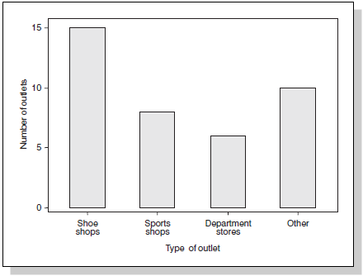
Bar Graph/Chart
Number of outlets selling trainers by type of outlet

Slide 8
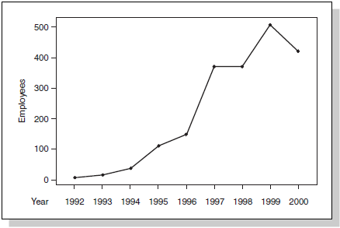
Line Chart
Employees of a computer games company

Slide 9
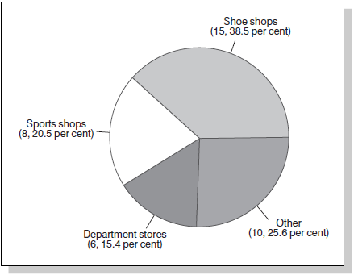
Pie/Circle Graph
Number of outlets selling trainers by type of outlet

Slide 10
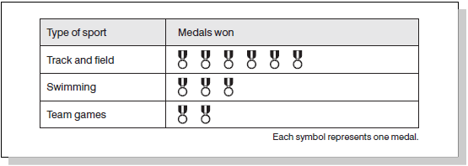
Pictograph
Pictograph of the number of medals won by type of sport

Slide 11
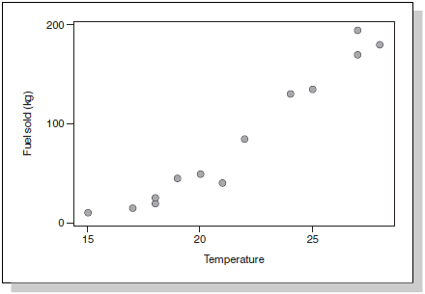
Scatterpoint/Scatter Diagram
A scatter diagram of temperature and barbecue fuel sold

Slide 12
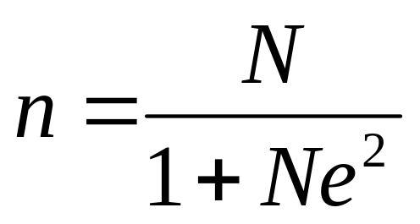
In doing a research, if the population is too big to handle, a substantial number of samples is acceptable. One way of getting a number of samples is by Slovin’s formula.
where
n = sample size
N = population size
e = margin of error

Slide 13
Remark: If accuracy or results is needed, studying the whole population or increasing the number of sample over and above what is acceptable will guarantee good results.
Surveys are usually designed to provide an estimate of the feelings or characteristics or a population at a given time.
Example: If the election is held now, Noynoy will win, says SWS.
Results of a survey is unlikely to equal exactly that of the entire population but a good estimate can be obtained by reducing possible errors.
One possible reason for the non-equality of sample survey to population is the “sampling error”. It is the difference in the survey results between sample and population.

Slide 14
The strength of the information in a survey is measured by the margin of error. It can be thought of at the 95% confidence interval.
Examples:
Suppose in the Aquino-Villar poll, e=±10% and in a sample of 100 people who intend to vote, 55% were for Aquino while 45% were for Villar. Determine the confidence intervals for each candidate.
Suppose now the survey is 1000 respondents who intend to vote, 550 (55%) said they will vote for Aquino while 450 (45%) will vote for Villar. This time the survey is done at e=±3%. Determine the 95% confidence interval for the proportion of support for the two candidates.

Slide 15
Find n if N=10,000 and e=5%.
Find n if N=10,000 and e=1%.
What happens to the sample size n as the margin of error e decreases?

Slide 16
Sampling Techniques
Sampling is the process of selecting samples from a given population.
Types of Sampling Techniques
Probability Sampling
- Simple Random Sampling
- Systematic Sampling
- Stratified Random Sampling
- Cluster Sampling
Non-probability Sampling
- Convenience Sampling
- Quota Sampling
- Purposive Sampling

Slide 17
Probability Sampling
Samples are chosen in such a way that each member of the population of a known though not necessarily equal chance of being included in the samples.
Advantages:
It avoids biases that might arise if samples were selected based on the whims of the researcher.
It provides the basis for calculating the margin of error.

Slide 18
Probability Sampling
Simple Random Sampling
- Samples are chosen at random with members of the population having a known or sometimes equal probability or chance of being included in the samples
a. Lottery or Fish Bowl Technique– Randomly draws the desired number samples. This is relatively easy for small populations but complicated and time consuming for large populations.
b. Generation of Random Digits – Computers and even calculators can be used to generate random digits. The randomly produced digits can be used to pick your samples. A complete listing of the members of the population is needed.

Slide 19
Probability Sampling
Systematic Sampling
- This involves choosing the kth member of the population with k=N/n but there should be a random start.
Example: Choose a sample size of 10 from N = 500 using systematic random sampling.
Step 1: Determine the period k: k = 500/10 = 50. This means that you include every 50th member of the population after choosing a random start.
Step 2. Put the random start, say at 15.

Slide 20
Probability Sampling
Step 3: Include in the samples the members with the associated digits: 15, 65, 115, 165, 215, 265, 315, 365, 415, and 465.
Stratified Random Sampling
- This method is used when the population is too big to handle, thus dividing N into subgroups, called strata, is necessary. Samples per stratum are those randomly selected but considerations must be given to the sizes of the random samples to be selected from the strata.
A process that can be used is proportional allocation. This procedure chooses sample sizes proportional to the sizes of the strata.

Slide 21
Probability Sampling
Example: A survey to find out if families living in a certain city are in favor of charter change will be conducted. To ensure all income groups represented, respondents will be divided into
Class A – high income
Class B – middle income
Class C – low income
Strata Number of Families
A 1,000
B 2,500
C 1,500
N=5000

Slide 22
Probability Sampling
Using a 5% margin of error, how many families should be included in the survey?
Ans: n=370
Using proportional allocation, how many from each group should be taken as samples?
Ans: A=74, B=185, C=111

Slide 23
Probability Sampling
Cluster Sampling
- Groups, instead of individuals, are chosen. In cluster sampling, you will draw the members of the sample by group or cluster and then you select a sample from each group or cluster individually.
Example: Determine the average daily expenses of families living in QC. Assume there are 300 barangays in QC. Using cluster sampling, you can draw a sample of 30 barangays using simple random sampling and get a certain number of families from each of the 30 barangays.

Slide 24
Non-Probability Sampling
Each member of the population does not have a known chance of being included in the sample. Instead, personal judgment plays a very important role in the selection.
Remark: Non-probability sampling is one of the sources of errors in research.
Convenience Sampling
- This type is used because of the convenience it offers to the researcher.
Example: Gathering data through telephone

Slide 25
Non-Probability Sampling
Quota Sampling
- similar to the stratified random sampling.
- the only difference is that in stratified sampling, the selection of the members of the samples is done randomly.
Example: To get the most popular noontime show, each field researcher is given a quota of 200 viewers per area.
Purposive Sampling
- Respondents are chosen based on pre-determined criteria set by the researcher.
Example: Suppose a research is about the satisfaction of Mapua IT-1 students in online registration. Of course, only Mapua IT-1 students will be the respondents.

